Slide 1
PROBLEM SOLVING TECHNIQUES PART -2 (Algorithm,flowchart,psedocode)

Slide 2
Algorithm
An algorithm is a step-by-step procedure or formula for solving a problem. It consists of a set of instructions that are executed in a specific order to achieve a desired outcome. Algorithms are essential in programming and problem-solving since they provide a structured way to approach complex tasks.
Example: Find the largest of two numbers.
Steps:
Start
Input two numbers (A, B)
Compare A and B
If A > B, output A is larger
Else, output B is larger
End

Slide 3
Benefits of algorithm
Efficiency and Optimization
Accuracy and Precision
Automation
Reusability
Clarity and Structure
Speeding Up Development

Slide 4
Flowchart
A flowchart is a graphical representation of an algorithm. It uses various shapes to denote different types of operations and the flow of control from one step to another. Flowcharts help in visualizing the steps of an algorithm and how data moves through the system.
Flowchart Symbols:
Oval (Terminator): Represents the start or end of the process.
Parallelogram (Input/Output): Represents input/output operations (e.g., receiving data or displaying results).
Rectangle (Process): Denotes a process, such as a calculation or an action.
Diamond (Decision): Represents a decision point (e.g., an if/else condition). It has multiple exit points based on conditions (usually two: true or false).
Arrow (Flow line): Shows the direction of flow between steps in the process.
Circle (Connector): Connects different parts of the flowchart when the flow is complex and jumps to different parts.

Slide 5
Example Flowchart
Let’s design a simple flowchart to find the largest of two numbers:
Start (Oval)
Input A and B (Parallelogram)
Is A greater than B? (Diamond: Decision)
If true: Output A is the largest (Parallelogram)
If false: Output B is the largest (Parallelogram)
End (Oval)

Slide 6
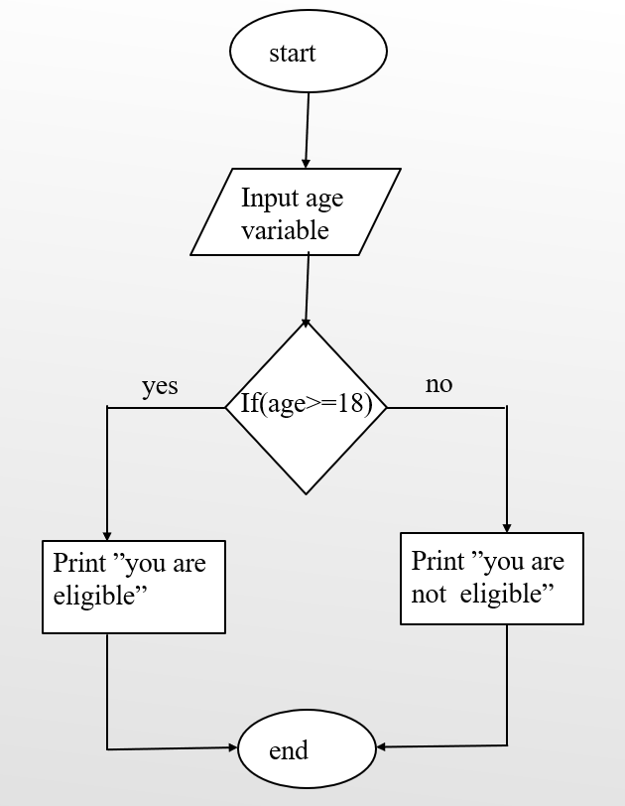
Draw flowchart for finding the person is eligible for voting or not.

Slide 7
Pseudo code
Pseudocode is an informal way of writing an algorithm using simple, natural language. It is not bound by syntax rules of programming languages, but it follows the logic of structured programming. Pseudocode serves as a bridge between the flowchart and actual code, providing a clear idea of what the code should do before it is implemented.

Slide 8
Example:
If “age >=18”
print response
“you are eligible for voting”
Else “age < 18”
print response
“you are not eligible for voting”

